Slide 1

Capital Agent
Built for Beginners. Powered for Pros.
WeHack 2025 | Timeless Moments Awaits

Slide 2
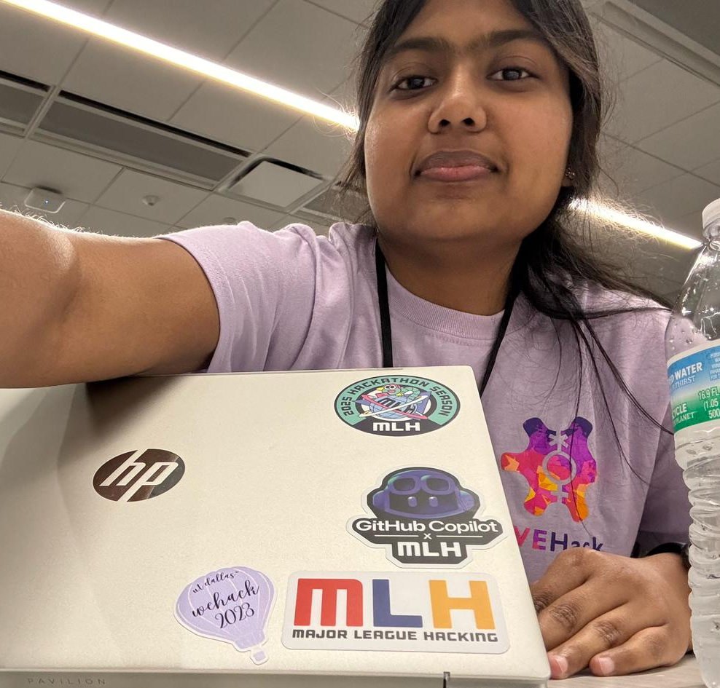



Agents
Varsha
Harshitha
Nanddanaa
Chinmayi

Slide 3
Vision - Problem Statement
People struggle with investment decisions due to hidden risks, financial complexity, and fast-moving markets, our app acts as a virtual detective.
Our goal: Make smart, safe and personalized real estate + stock investing choices
Capital Agent = AI detective for your financial future

Slide 4
Features
Property risk + trend analysis
Stock sentiment + investment risk (Low / Medium / High)
Personalized chatbot (Gemini + MongoDB)
Recommends portfolio diversification suggestions based on history

Slide 5
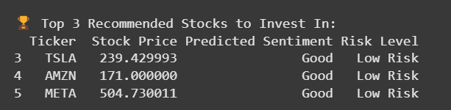
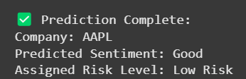
Stock Investment Analysis
Recommend top 3 stocks to invest in
Trained LSTM model
Analyzes popular stocks
News Sentiment – finviz website
Stock prices – Yahoo Finance API
Risk level score – Set based on sentiment + stock price
Picks top 3 highest scoring stocks
2. Analyze a particular stock investment’s risk
Trained LSTM model
News Sentiment – finviz website
Stock prices – Yahoo Finance API
Risk level score – Set based on sentiment + stock price

Slide 6
Property Investment Analysis
Data parameters - Locality, estimated value, sale price, tax rate, avg voltage, avg soil moisture, avg noise sensor value, avg temperature, zipcode, crime index
Trained RandomForestClassifier model – Predicts Investment risk (low/medium/high)
Flask interface – 2 API endpoints :
User sends property details
–> returns risk score from trained model (saved in MongoDB)
User sends a question through prompt –
Fetch’s user’s history from MongoDB + user’s question
-> returns answer from Gemini 1.5 Flash model to generate a natural-language response

Slide 7






Tech Stack

Slide 8
Devpost Submission
https://devpost.com/software/capitalagent?ref_content=my-projects-tab&ref_feature=my_projects

Slide 9
Figma Frontend
https://www.figma.com/proto/Tpg5hhvpCXP5AzlHWtwzKN/Developer-Portfolio-Design--Community-?node-id=202-392&t=OZT0pm87vchKcJlu-1&scaling=min-zoom&content-scaling=fixed&page-id=0%3A1&starting-point-node-id=202%3A392&show-proto-sidebar=1

Slide 10
Project Demo
https://youtu.be/Je8s4Q-lgc4
GitHub Repo
https://github.com/HarshithaDA/WeHack-2025

Slide 11
Future Plans
Integrate a functional frontend with developed design
Make the chat bot more conversational and customised to personal profile
Use user’s historic data to recommend better

Slide 12
What are we proud of
Beginners in fintech and developing websites
Built everything end-to-end in under 15 hours
Works for both property and stock domains

Slide 13
What Went Wrong
Google GenAI v1beta versioning nightmares
Multiple package conflicts and re-installs
Integrating Gemini + MongoDB memory took time

Slide 14
Thank you
Thank you

